Slide 1

Emma Pedersen - Project Owner Siddhi Panchal - SCRUM Master Christian Hernandez David Li Vanessa Webber

Slide 2
HotelLocal
Most people go to big websites like Hotels.com to search for places to stay and they are suggested big franchise hotels instead of local or family owned ones. We are going to make a platform for those smaller hotels so they can be showcased without being overshadowed by the franchises.

Slide 3
High Level Goals
To be able to create a search option for a location
To be able to suggest family owned hotels within the searched area
To be able to give information about selected hotels and have an link to their website
To be able to create a platform to rate and review each hotel
To be able to sort or filter the suggested hotels by ratings and prices
To be able to give directions to the hotel by using a platform like Google Maps

Slide 4
User Stories
Sprint 1 - Functioning website, that allows user to view hotels each labeled with assoc. high-level goal
Sprint 2 User interaction with images, redirecting to other webpages each labeled with assoc. high-level goal
Sprint 3 Fulling functioning website with all features including Google Maps, …. each labeled with assoc. high-level goal

Slide 5
Sprint 1 : Functioning Website
User Story 1: As a user, I need to search for hotels based on location so that I can plan my stay.
User Story 2: As a user, I want to find a list of smaller hotels in the area to avoid picking the between the same 5 or 6 companies.

Slide 6
Sprint 2 : Expand on details of the hotels displayed to our customers
User Story 1: users are able to to find hotels with the search algorithm prominently displaying local/ family owned hotels
User Story 2: As a user, I want to read up on basic information for my hotel of choice in order to make a better informed decision.

Slide 7
Sprint 3 : Clean up design and add more features
User Story 1: As a user, I want to be able to see ratings of each hotel through our customer rating system, and also rate them myself.
User Story 2: As a user, I need to navigate to my desired hotel through a platform like Google maps so that I don’t get lost.

Slide 8
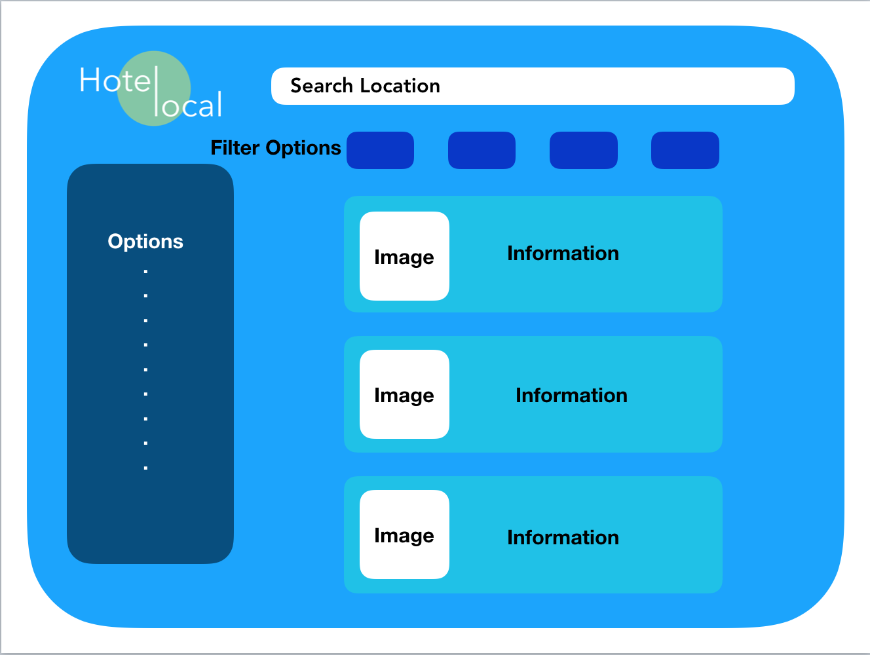
Architecture

Slide 9
Challenges/Risks
Challenge/Risk 1: Learning HTML
Challenge/Risk 2: Getting accustomed to API
Challenge/Risk 3: Collecting information from the hotels

Slide 10
Technologies
Technology 1: HTML is going to be our main programming language, CSS considered
Technology 2: Bootstrap
Technology 3: Visual Studio Code

